Slide 1
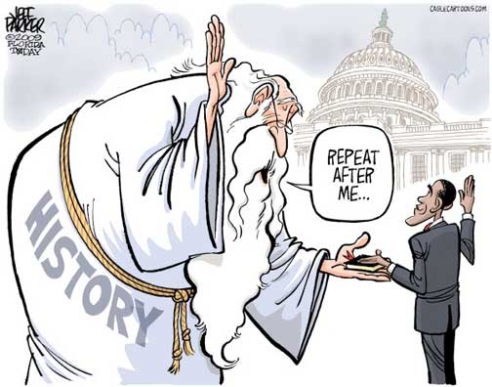
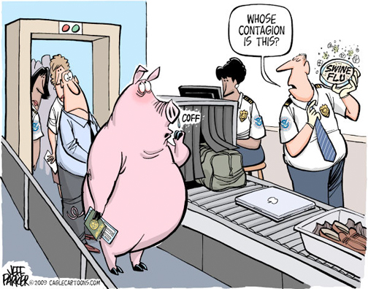
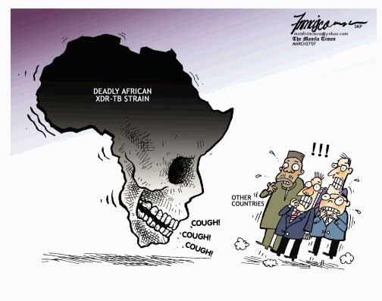
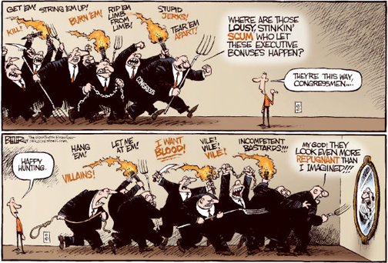
It’s No Laughing Matter
Understanding Political Cartoons

Slide 2
How Do I Know what the Cartoon is Saying?
5 Things to Look for:
1. Symbolism
Cartoonists use simple objects, or symbols, to stand for larger concepts or ideas.
After you identify the symbols in a cartoon, think about what the cartoonist intends each symbol to stand for.

Slide 3
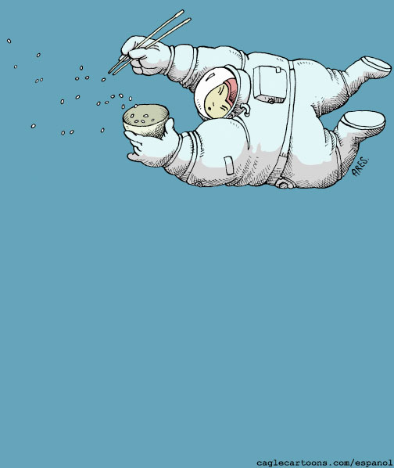
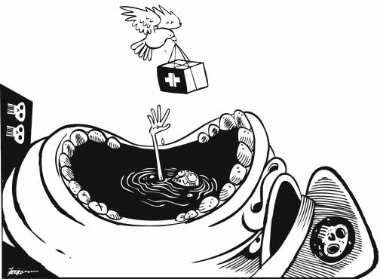
Symbolism:

Slide 4
How Do I Know what the Cartoon is Saying?
2. Exaggeration
Sometimes cartoonists overdo, or exaggerate, the physical characteristics of people or things in order to make a point.
When you study a cartoon, look for any characteristics that seem overdone or overblown. (Facial characteristics and clothing are some of the most commonly exaggerated characteristics.)
Then, try to decide what point the cartoonist was trying to make through exaggeration.

Slide 5
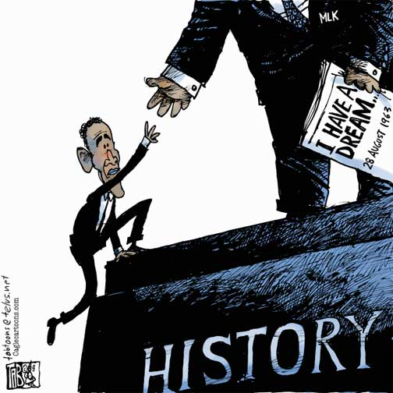
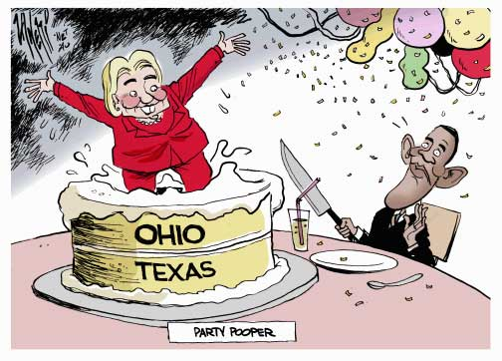
Exaggeration:

Slide 6
How Do I Know what the Cartoon is Saying
3. Labeling
Cartoonists often label objects or people to make it clear exactly what they stand for.
Watch out for the different labels that appear in a cartoon, and ask yourself why the cartoonist chose to label that particular person or object.
Does the label make the meaning of the object more clear?

Slide 7
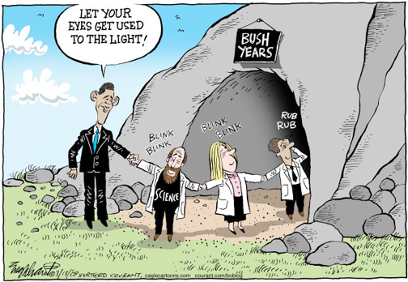
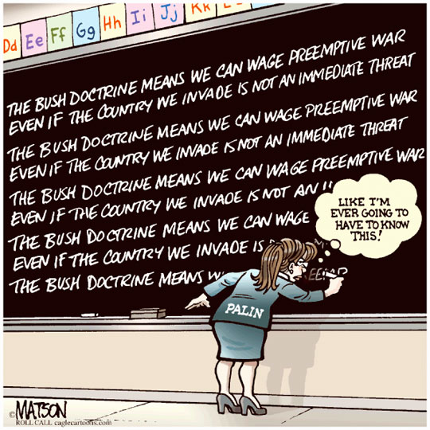
Labeling:

Slide 8
How Do I Know what the Cartoon is Saying
4. Analogy
An analogy is a comparison between two unlike things that share some characteristics.
By comparing a complex issue or situation with a more familiar one, cartoonists can help their readers see it in a different light.
After you’ve studied a cartoon for a while, try to decide what the cartoon’s main analogy is. What two situations does the cartoon compare?
Once you understand the main analogy, decide if this comparison makes the cartoonist’s point more clear to you.

Slide 9
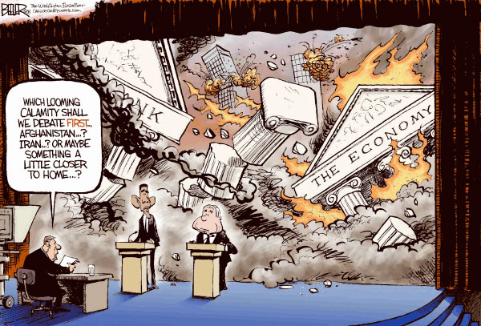
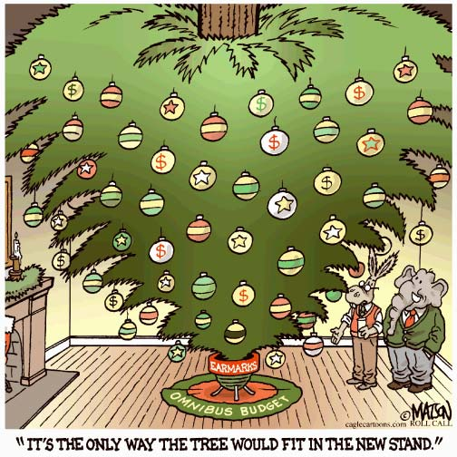
Analogy:

Slide 10
How Do I Know what the Cartoon is Saying?
Irony
Irony is the difference between the ways things are and the way things should be, or the way things are expected to be.
Cartoonists often use irony to express their opinion on an issue.
When you look at a cartoon, see if you can find any irony in the situation the cartoon depicts. If you can, think about what point the irony might be intended to emphasize.
Does the irony help the cartoonist express his or her opinion more effectively

Slide 11
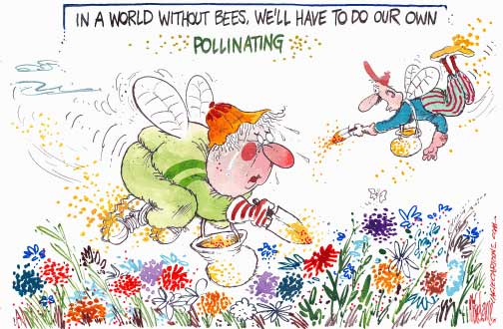
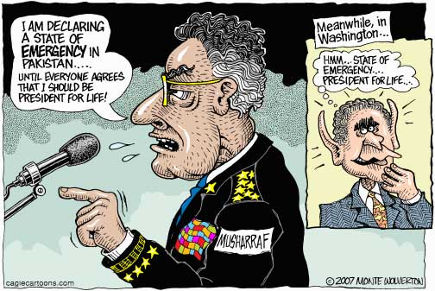
Irony:

Slide 12
Once you’ve identified the persuasive techniques that the cartoonist used, ask yourself:
What issue is this political cartoon about?
What is the cartoonist’s opinion on this issue?
What other opinion can you imagine another person having on this issue?
Did you find this cartoon persuasive? Why or why not?
What other techniques could the cartoonist have used to make this cartoon more persuasive?

